Slide 1

Health & Safety Procedures
Teacher Edition

Slide 2
Emergency Response
Fire
Fire Extinguishers
Assembly Areas
Evacuation Map
Lockdown
Medical Emergency
Epinephrine
CPR
Child Protection
Crisis Communication
School Emergency Response Team
National/Regional Emergency Contacts
Contents

Slide 3
Emergency Response
TEACHERS
Teachers shall be responsible for the supervision of students and shall remain with students until
directed otherwise. They shall:
1.
Take steps deemed necessary to
ensure the safety of students, staff, and other individuals in the
implementation of Emergency Management Response Protocols.
2.
Direct students in their charge according to established emergency procedures.
3.
Render first aid if necessary. Selected
school staff should be trained and certified in first aid,
and CPR.
4.
Teachers must have their Emergency Folders with them.
5.
Take attendance when the class relocates in the designated
assembly area.
6.
Report missing student
s and staff to GLTL/HOD using the Red/Green colored card
system to expedite this process.
7.
Assist as directed by the principal/incident commander.

Slide 4
Fire
On hearing the alarm:
Have the students calmly line up
Take your emergency folder
Escort students to the nearest emergency exit
Assemble at your designated assembly area
Take attendance
Hold up GREEN Card to show that your students are all present or a RED Card to indicate that students, who were present that day, are missing and report to Grade Level Leader/HOD. Administration will circulate and check in with your Grade Level Leader/HOD.
Remain with your class at the assembly area until you are given the all clear or are given directions to proceed to the evacuation areas.

Slide 5
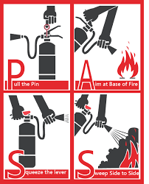
Fire Extinguishers
There are large red boxes located at the end of each hallway. Each red box contains a hose for the fire departments use as well as two different fire extinguishers.
The red fire extinguisher contains water and is to be used with ordinary combustibles such as wood, cloth, paper, rubber and many plastics. DO NOT use this red fire extinguisher on electrical fires.
The blue fire extinguisher is multi-purpose and may safely be used on all substances, including water.
Use the “PASSword” to help you remember how to use it:
P PULL the pin out.
A AIM low
S SQUEEZE the lever below the handle.
S SWEEP from side to side aiming at the base of the fire.

Slide 6
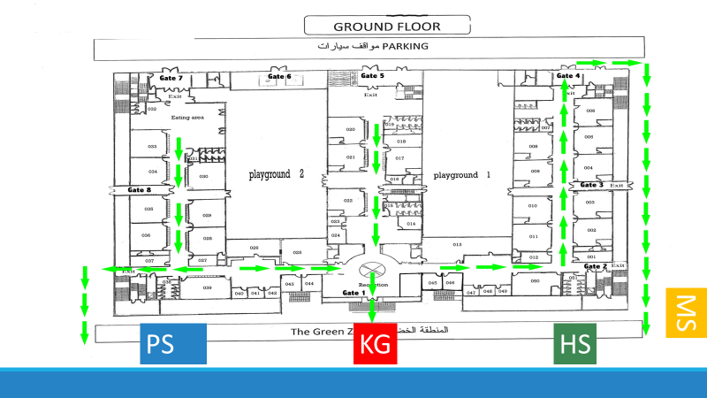


Evacuation Map
Street blocked by guards
Rally Point
Stage 2 Evacuation Route
Stage 3 Evacuation Route
ES

Slide 7
Stage 1 evacuation Assembly Areas
ES

Slide 8
Lockdown
For internal threat/immediate danger
You will hear 3 horn blasts on the PA followed by directions to lockdown the campus
Check the hallway and gather students inside designated areas
Lock or block the entry door of your designated area
Push furniture against the doors
Turn off the lights
Stay clear of all windows and close all curtains if possible
Move students out of sight and stay quiet
Silence all mobile phones
Do not allow students to use mobile phones during a lockdown
Do not open the door until an all-clear announcement has been made by the director or an administrator/police officer arrives at your door to release you

Slide 9
Medical Emergency
There are many situations that constitute a medical emergency that need emergency medical attention.
Quickly assess the situation and establish scene safety
Follow the steps of any known care plan
*In the event of an anaphylactic reaction administer epinephrine immediately*
Call out/telephone for additional help from an adult/contact the school nurse
Seek further medical attention by dialing 112
Give directions or delegate an appropriate staff member to direct EMS to the scene
School Name: Kuwait Bilingual School 2
Area: Al Jahra
Block: 1
PACI: 20286819
File an accident report

Slide 10
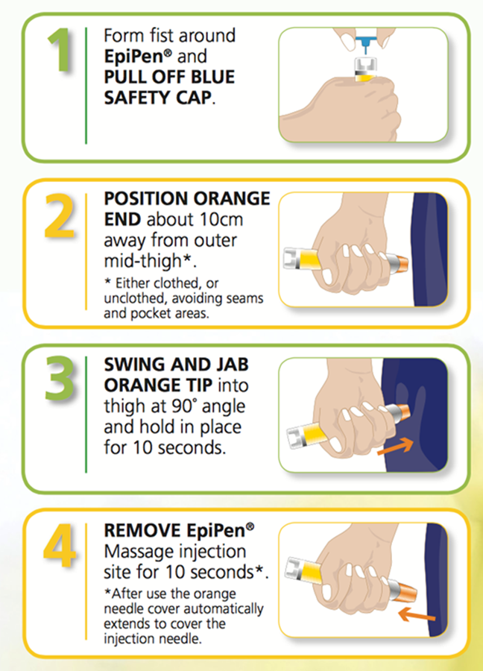
Epinephrine
2
Epinephrine by injection is the treatment for anaphylaxis.
Quick administration is key – a delay can be deadly

Slide 11

CPR
2
o
112

Slide 12
Child Protection
Kuwait Bilingual School follows and adheres to child protection mandates and guidelines as stipulated by the Kuwait National Child Protection Program.
Child abuse, as defined by the Kuwait National Child Protection Program, “constitutes all forms of physical and/or emotional ill-treatment, actual, potential and suspected abuse, neglect, or negligent treatment, commercial or other exploitation, or serious deprivation resulting in actual or potential harm to the child’s health, survival, development, or dignity in the context of relationships or responsibility, trust or power.” It refers to any person of 18 years of age or younger.
Kuwait law and the Kuwait Child Protection Program specifies that all “school teachers” are mandated reporters, meaning that they are legally obliged to report suspected child abuse. KBS employees are required to report suspected child abuse if they have reasonable suspicion or knowledge that child abuse is/has occurred. The employee is required to make a report to the divisional counselors, School Emergency Response Team, or director.

Slide 13
Crisis Communication
In the event of a crisis:
Teachers will be notified via broadcast message by the School Emergency Management Response Team
A follow-up email may be sent by the director or School Emergency Management Response Team
Morning Faculty Meetings and End-of-Day-One Faculty/Staff Meetings will be used to provide accurate, updated information, to review procedures, ensure wide-spread common information, and address misinformation or rumors
An official statement will be shared with the community by the director or School Emergency Management Response Team
When communicating with students and parents after a crisis, do not speculate; stick to the facts that have been verified and communicated

Slide 14
School Emergency Response Team
Director – Sinae VanHaastert 50284864
ES Principal – Shaimaa Mohamed– 66180559
MS Principal –Antoine Saadeh– 50277527
HS Pastoral Principal – Kalvin Jordan– 96967444
KG AP –Jumana Othman - 96621839
Maintenance Manager – Maheesh– 60745463
Head Nurse –Barihan Mahmoud – 51475882

Slide 15

National/Regional Emergency Contacts
Emergency Medical Services (Police, Fire, and Ambulance ) – 112
American Embassy – 22591001
British Embassy – 2259 4320
Canadian Embassy – 22563025
Egyptian Embassy - 2251 9955
South African Embassy - 2561 7988
American Red Cross – 23894444
Kuwait Red Crescent – 24818084
Poison Control Center (Saha Institute) – 50603031

